Slide 1
ReneWind Failure Detection
PGP-DSBA _ ReneWind Project
February 05, 2024

Slide 2
Contents / Agenda
Executive Summary
Business Problem Overview
Solution Approach
EDA Results
Data Preprocessing
Model performance summary for hyperparameter tuning.
Model building with pipeline
Appendix

Slide 3
Executive Summary
Considering recall performance on the validation set and the ability to generalize, the tuned random forest was identified as the best model
The model trained on under-sampled data generalizes better on accuracy than on recall but worse on precision and F1
V36 and V18 are by far the most important features of the tuned random forest classifier trained on undersampled data, followed by V39; for each of these 3 variables, an increase reduces the chances of a failure
About 95% of the cases registered no failure; 5% of failure is obviously in minority but is large enough to impact ReneWind’s maintenance cost
ReneWind should seek means to improve, as much as possible, the values of V18, V36, and V39
ReneWind might want to consider cost-effective control measures for the less important factors

Slide 4
Business Problem Overview
Wind Energy is part of the increasingly popular renewable energy sources
In response to the need to reduce maintenance cost associated with this source of energy, the U.S. Department of Energy has published a guide to achieving operational efficiency via predictive maintenance
ReneWind, a company created to improve Wind Energy production, has collected data on generator failure of wind turbines using sensors fitted across components within the production environment
The data collected has been ciphered and submitted for analysis so various classification models can be built and assessed – the task that defines the raison-d’etre of this project

Slide 5
Solution Approach
To accomplish this task, we proceeded as follows:
We started out by carrying out Exploratory Data Analysis of the data provided to get an overview of the data and to uncover patterns within and across the different variables
We then moved on to Data Pre-Processing, essentially splitting the data into predictor and target variables, training, validation, and test sets, and carrying out imputation of missing values using the column median strategy separately for the training, validation, and test data sets, to avoid data leakage
Next, we went on to build and evaluate several models with default parameters as well as with tuned parameters, employing techniques such as oversampling and undersampling to further explore model tuning options
Finally, after evaluation on the validation set, one of the models was chosen as the best performing model, a pipeline was used to operationalize the chosen model, and its performance was evaluated on the test dataset

Slide 6
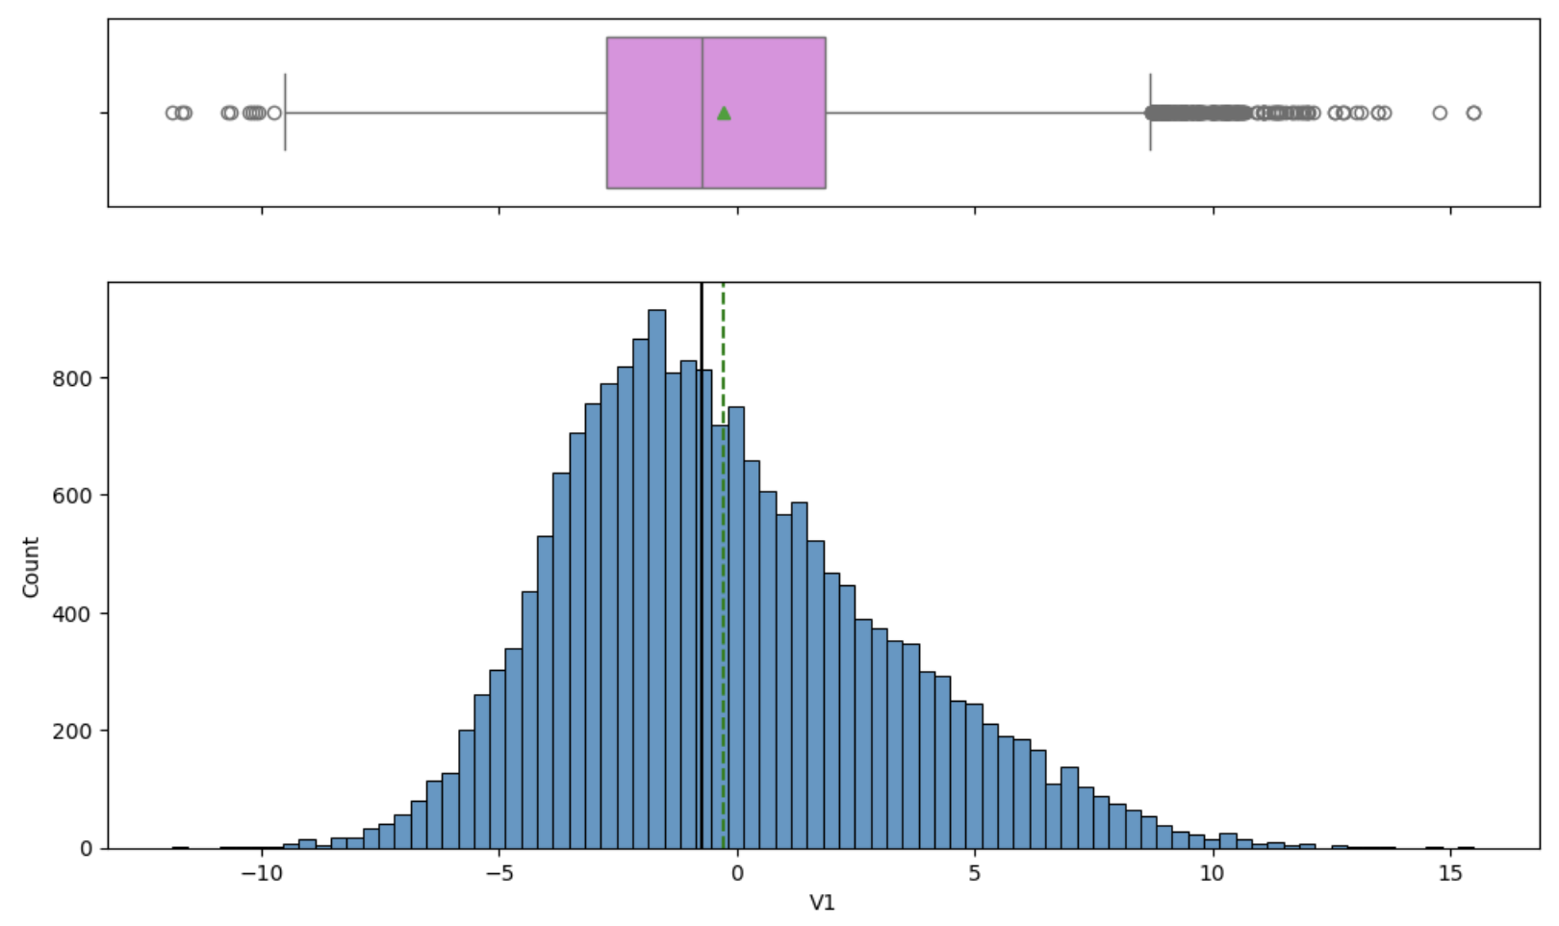
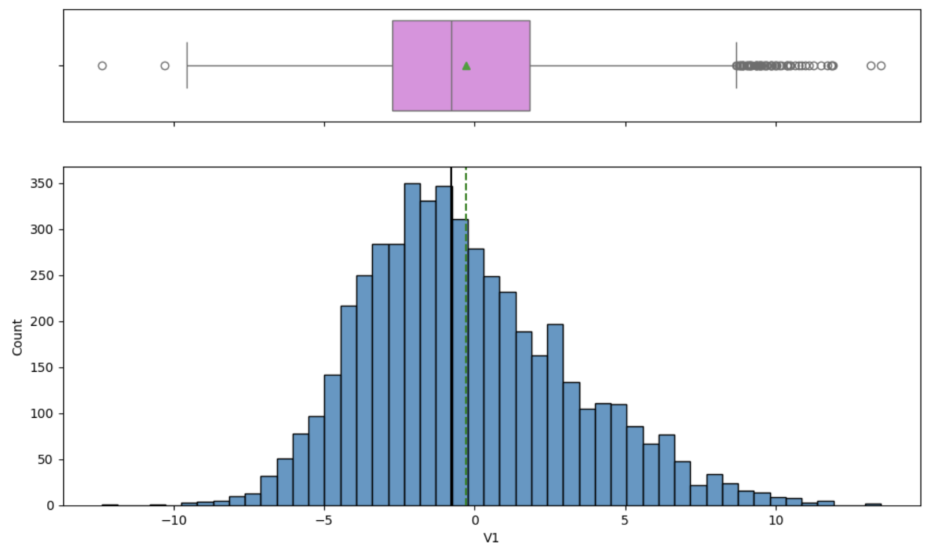
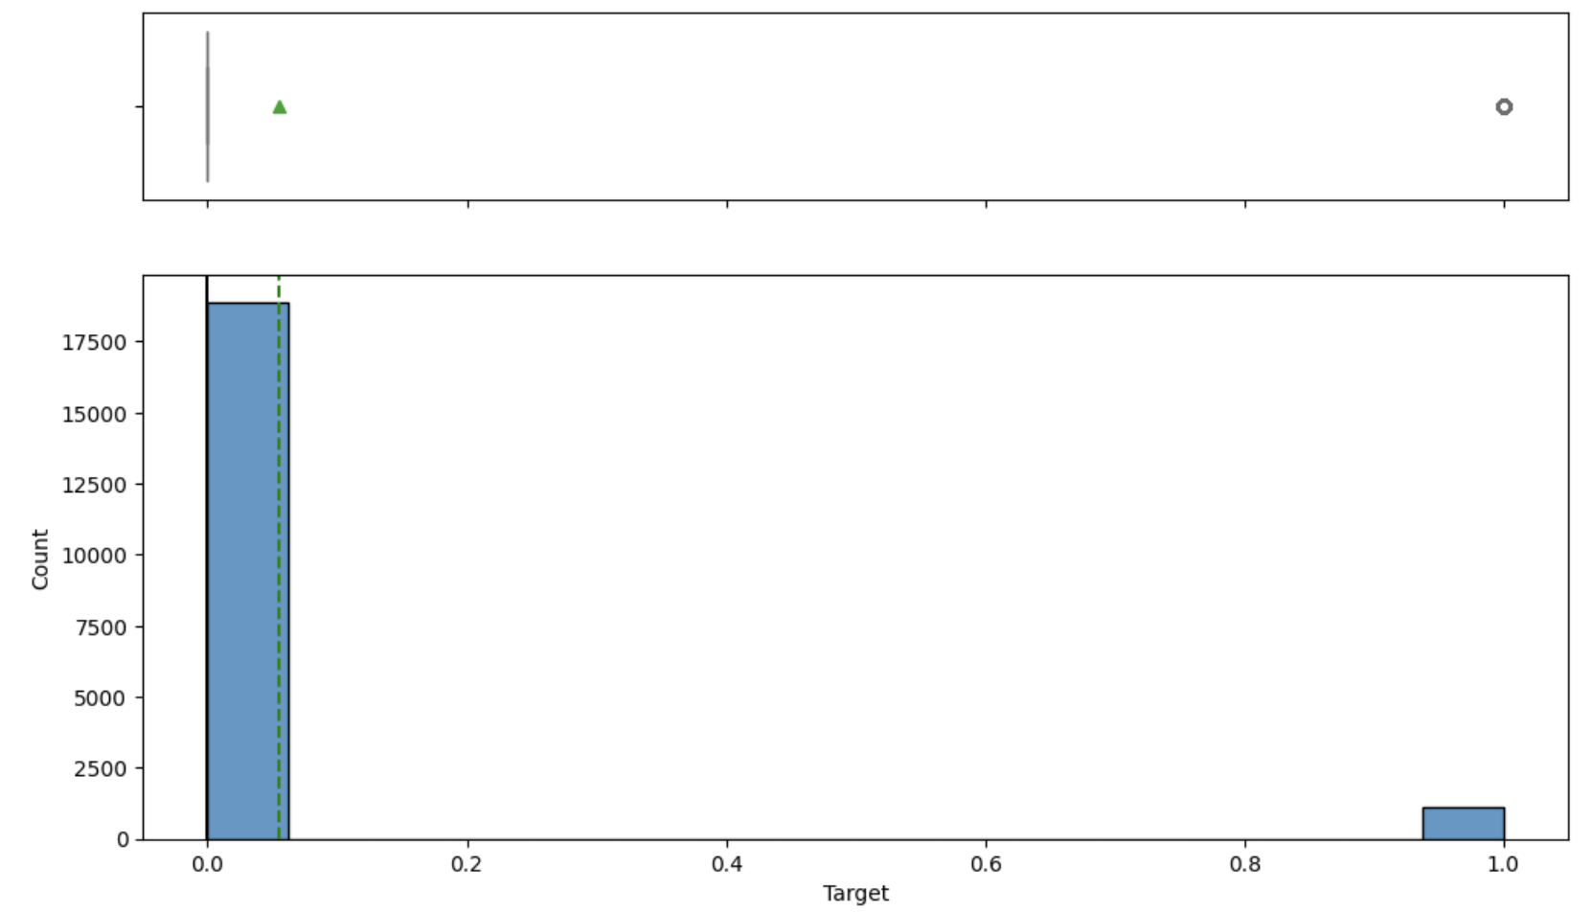

EDA Results: Univariate Analysis
Training Data
Test Data
From the plots of the variables of both the train and test datasets, we have confirmation that all except the target variable have a quasi-normal distribution
We also have confirmation that cases of failure (Target = 1) constitute a minority class
Link to Appendix slide on data background check

Slide 7
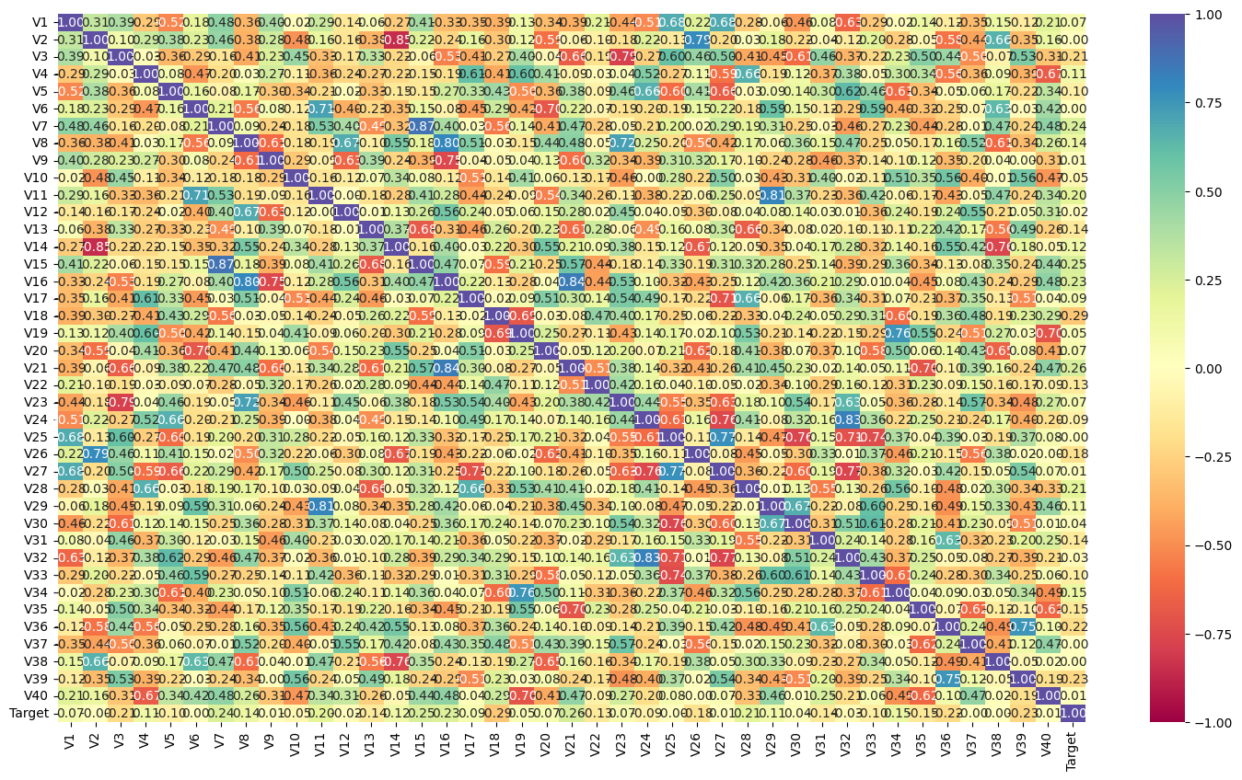
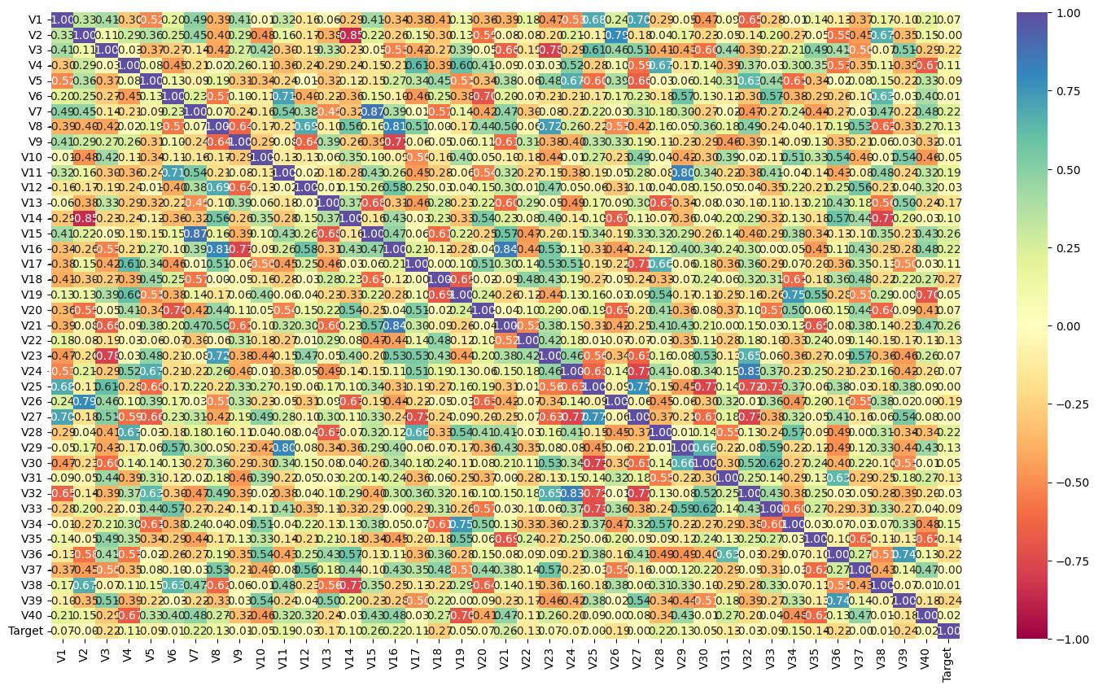
EDA Results: Bivariate Analysis: Correlation Check
Training Data
Test Data
In both the training and test data sets, significant levels of positive correlation are observed between some variables; for example between V7 and V15, V8 and V16, V11 and V29, V16 and V21, and V24 and V32
In both sets, significant levels of negative correlation are also observed between some variables; for example between V2 and V14, V3 and V23, V6 and V20, V9 and V16, V14 and V38, V17 and V27, V19 and V40, V24 and V27, V25 and V30, V25 and V32, V25 and V33, and V27 and V32
Link to Appendix slide on data background check

Slide 8
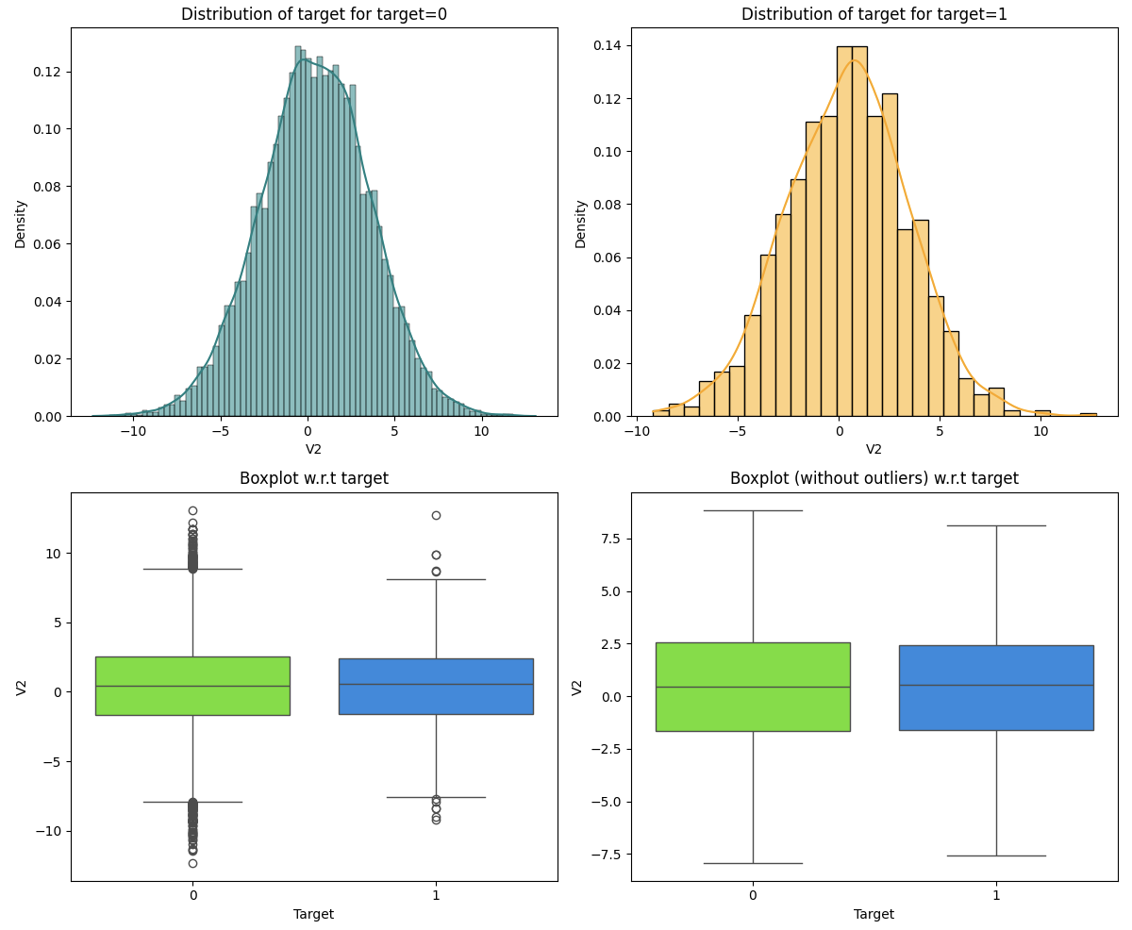
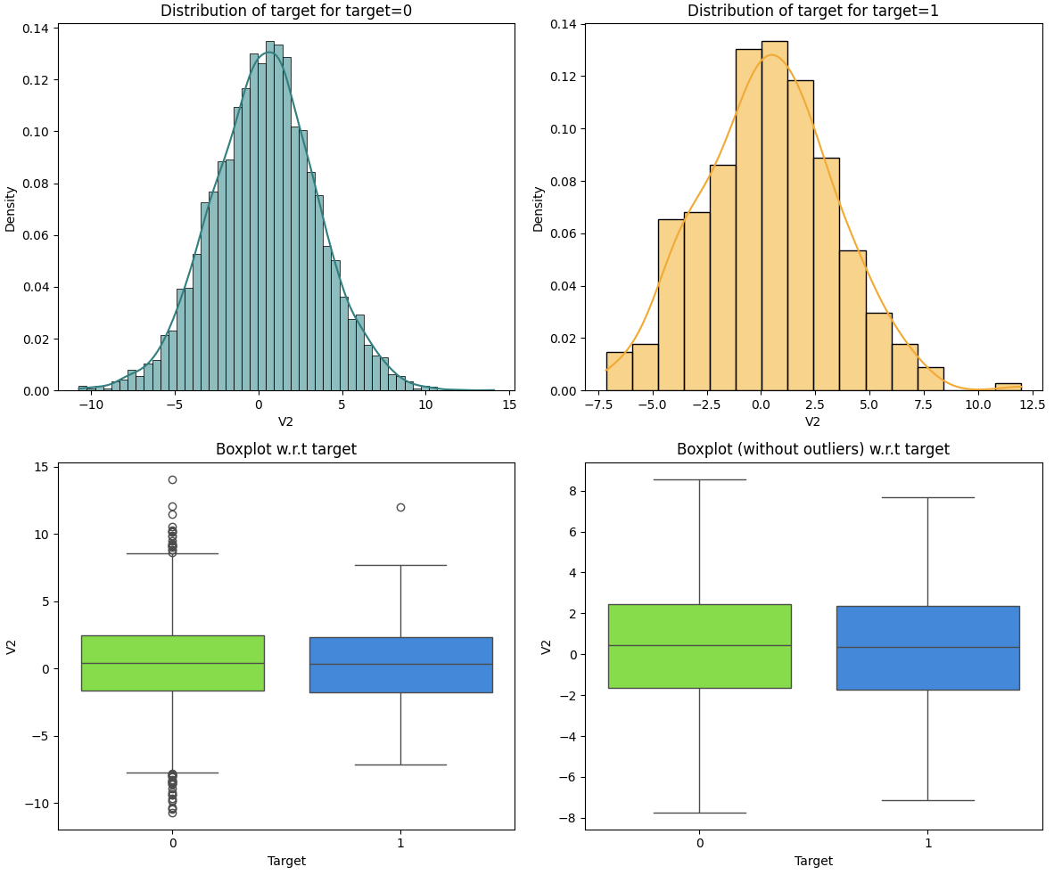
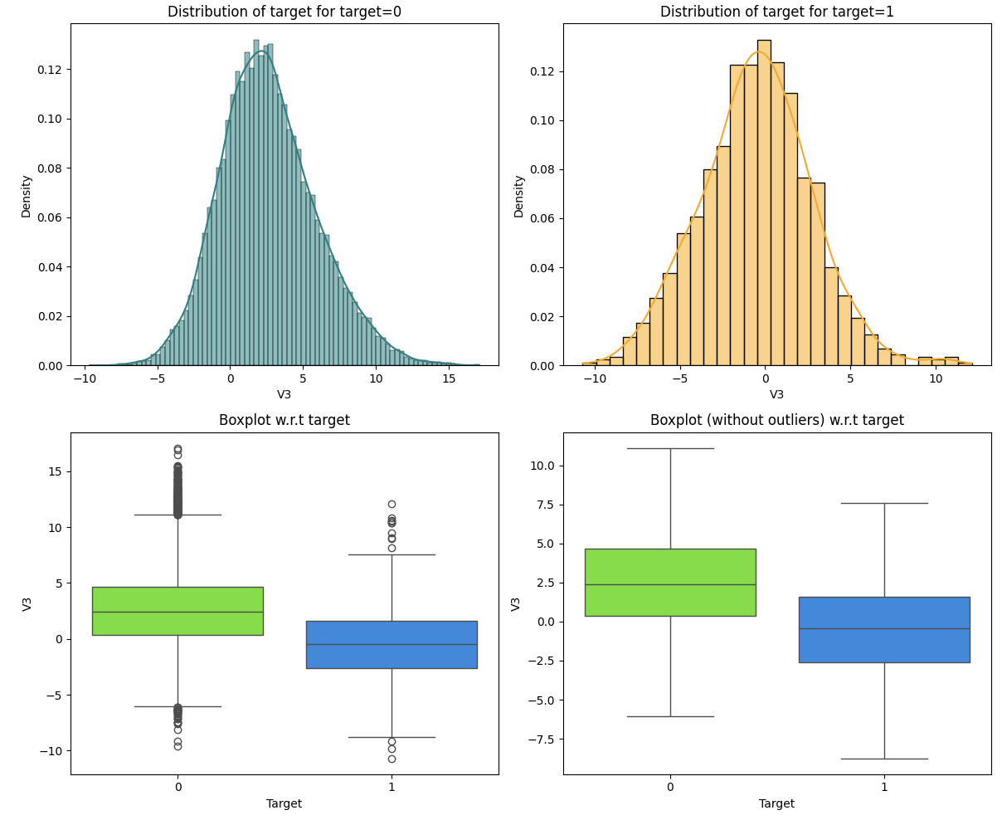
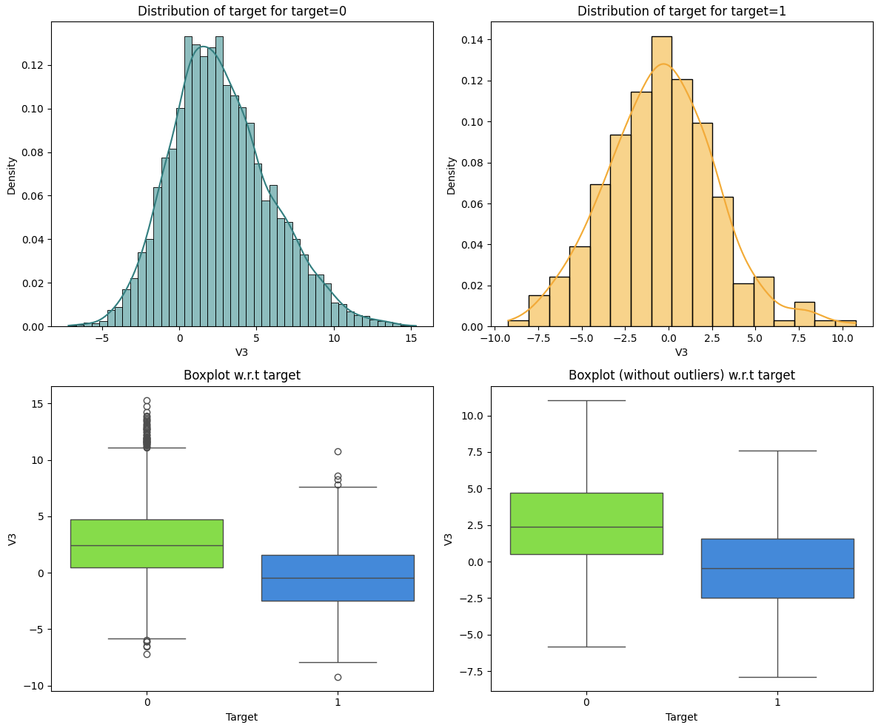
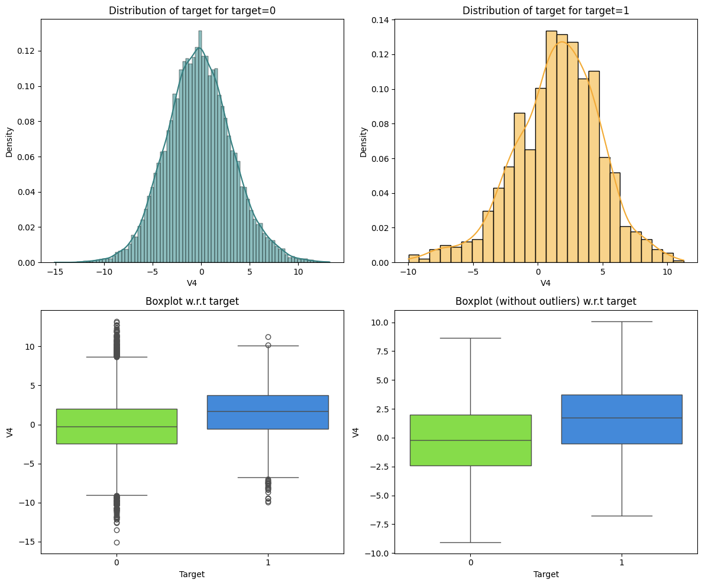
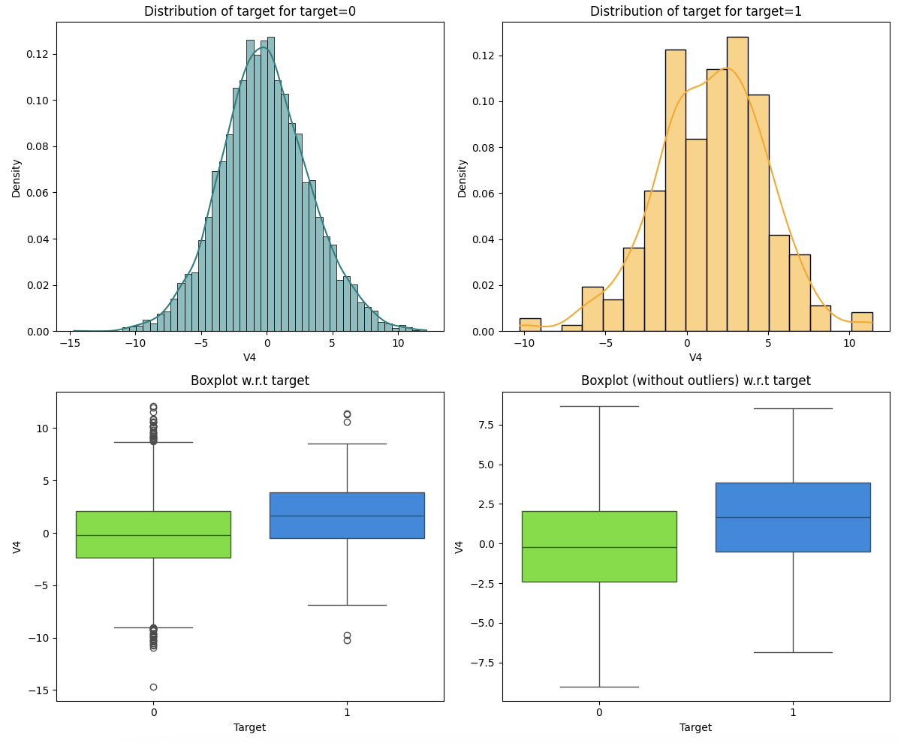
EDA Results: Bivariate Analysis: Distribution with respect to Target
Training Data
Test Data
Both the training and test sets display similar distribution with respect to the Target variable; in both sets, almost all the variables display a quasi-normal distribution for each of the two classes in the Target
Tend to have higher values for Target=1: V1, V4, V7, V8, V11, V14, V15, V16, V17, V19, V20, V21, V23, V28, V29, V34
Tend to have higher values for Target=0: V3, V5, V10, V13, V18, V23, V24, V26, V31, V32, V33, V35, V36, V39
Similar value trends for both Target values: V2, V6, V9, V12, V25, V27, V30, V37, V38, V40
Link to Appendix slide on data background check

Slide 9
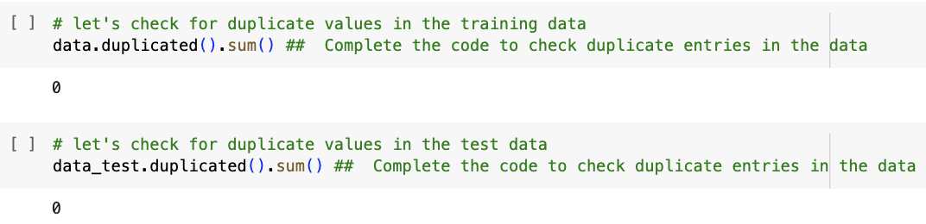
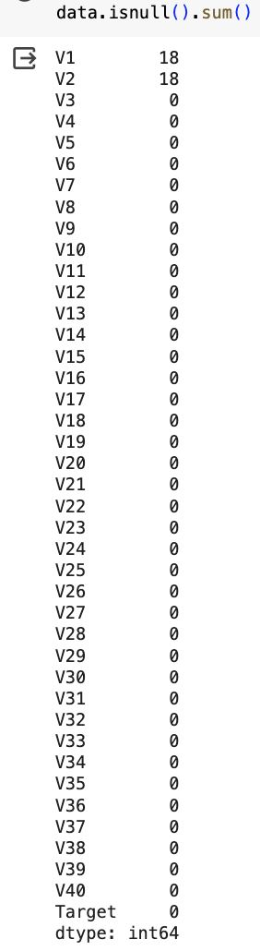
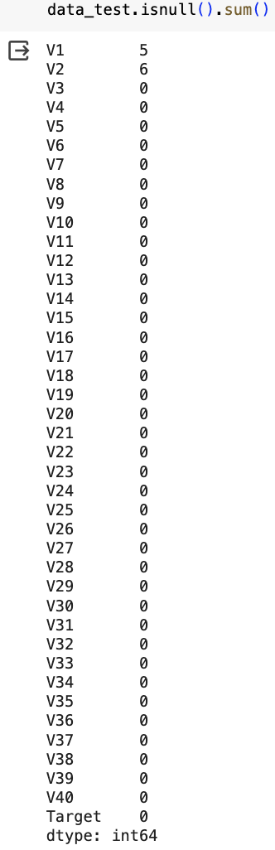
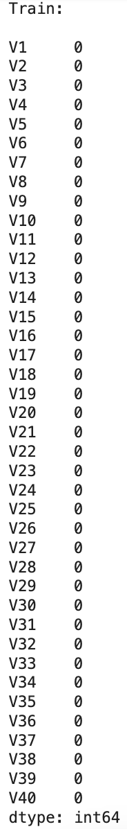
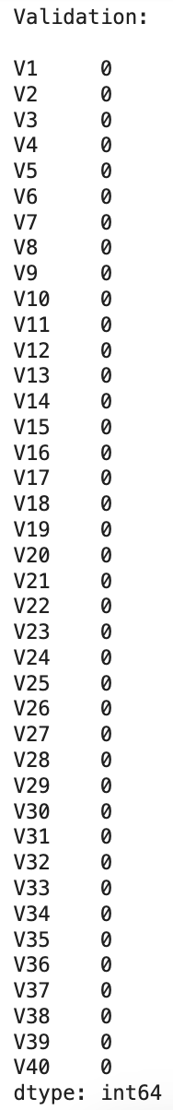
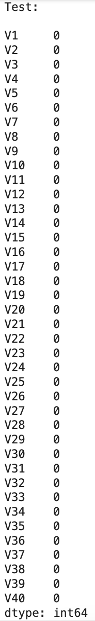
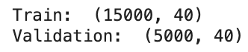
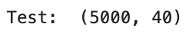
Data Preprocessing
Before Data Split and Imputation
After Data Split and Imputation
Neither the training data nor the test data has duplicated data
In the training data, columns V1 and V2 have 18 missing values each
In the test data, column V1 has 5 missing values whereas column V2 has 6 missing values
The X dataframe of the training dataset has 15,000 rows and that of the validation dataset has 5,000
Both have 40 columns since the target variable has been excluded
The X dataframe of the test dataset has 5,000 rows and 40 columns since the target variable has been excluded
After simple imputation using the column median strategy, the missing values have been eradicated from the training, validation, and test datasets

Slide 10
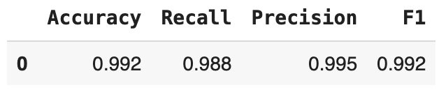

Model Performance Summary: AdaBoost Tuning using oversampled data
Training Data
The performance of AdaBoost Classifier with the best randomly chosen hyperparameters trained on oversampled data has a similar validation recall as that with default hyperparameters trained on the same
The model with the best randomly chosen hyperparameters is overfitting the oversampled data.
Validation Data
Link to Appendix slide on model assumptions

Slide 11
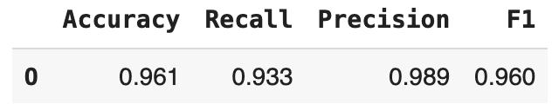
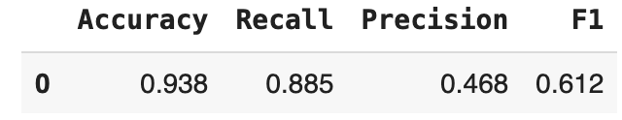
Model Performance Summary: Random Forest Tuning using undersampled data
Training Data
The performance of the RandomForest Classifier with the best randomly chosen hyperparameters trained on undersampled data has a slightly worse validation recall than that with default hyperparameters trained on the same
In addition, it generalizes worse than the model with default hyperparameters trained on undersampled data.
Validation Data
Link to Appendix slide on model assumptions

Slide 12
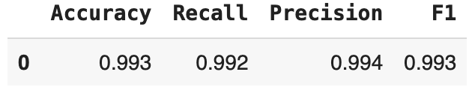
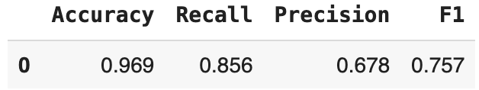
Model Performance Summary: Gradient Boosting Tuning using oversampled data
Training Data
The performance of the Gradient Boosting Classifier with the best randomly chosen hyperparameters trained on oversampled data has a slightly worse validation recall than that with default hyperparameters trained on the same
The model with the best randomly chosen hyperparameters is overfitting the oversampled data
Validation Data
Link to Appendix slide on model assumptions

Slide 13
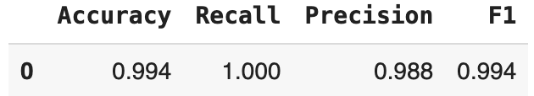
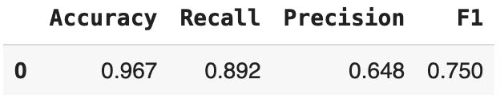
Model Performance Summary: XGBoost Tuning using oversampled data
Training Data
The performance of the XGBoost Classifier with the best randomly chosen hyperparameters trained on oversampled data has a better validation recall than that with default parameters trained on the same
However, the model still overfits the oversampled data
Validation Data
Link to Appendix slide on model assumptions

Slide 14
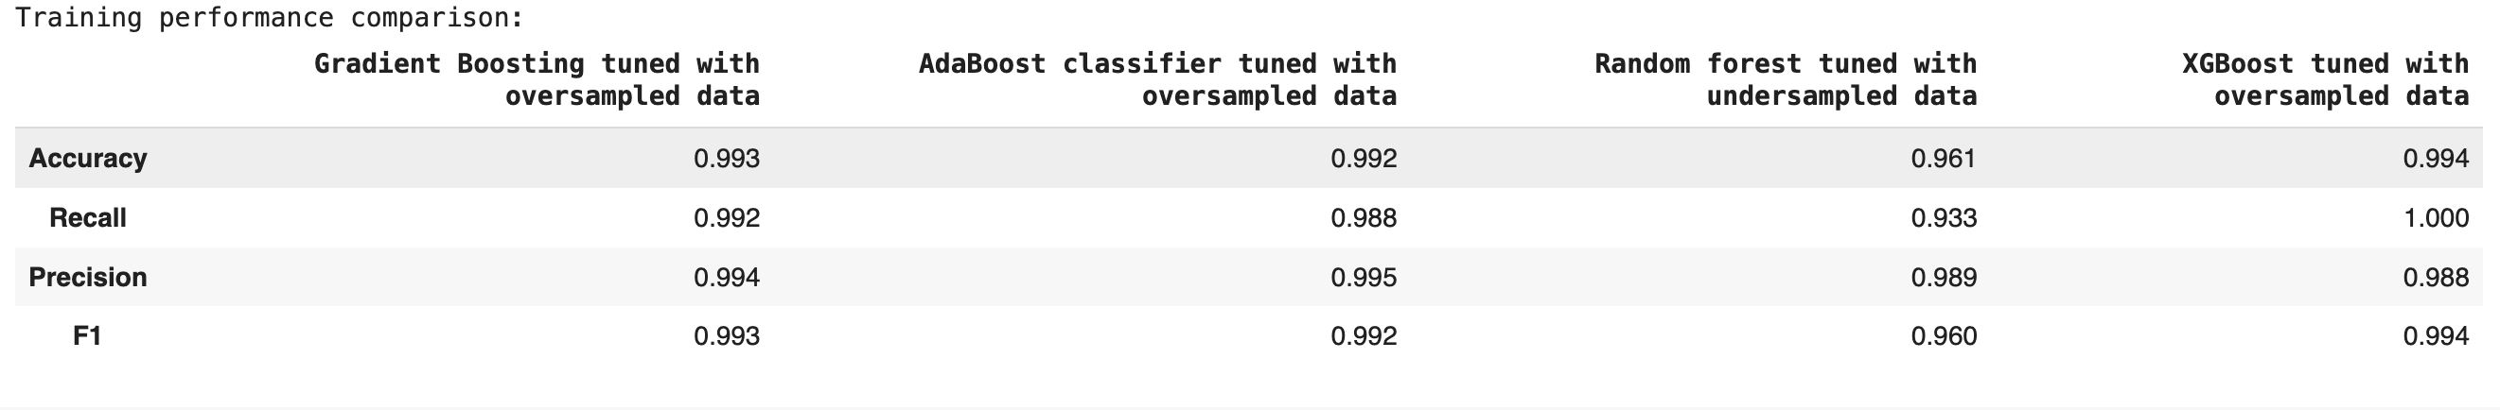
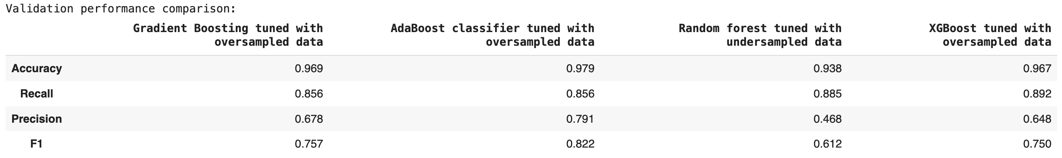
Model Performance Summary: Model performance comparison and choosing the final model
Accuracy: The tuned AdaBoost Classifier trained on oversampled data has the best validation score and also generalizes the best
Recall: The tuned XGBoost Classifier trained on oversampled data has the best validation score but the tuned Random Forest Classifier trained on undersampled data, which has the second best validation score, generalizes better
Precision: The tuned AdaBoost Classifier trained on oversampled data has the best validation score and also generalizes the best
F1: The tune AdaBoost Classifier trained on oversample data has the best validation score and also generalizes the best
Considering that recall is the most important measure for this project, the tuned Random Forest Classifier trained on undersampled data will be retained as the best model since it generalizes best and has the second best validation score
Link to Appendix slide on model assumptions

Slide 15
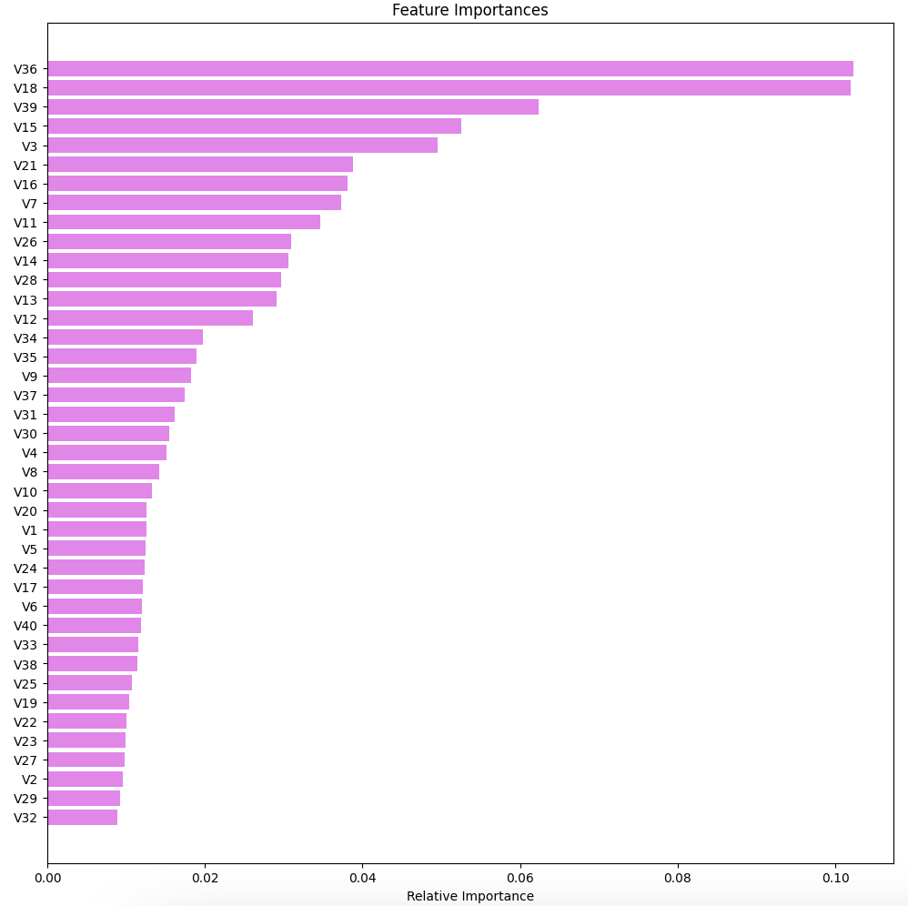
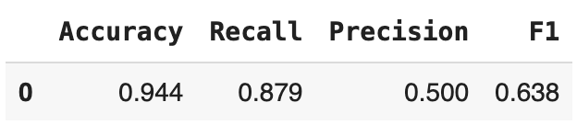
Model Performance Summary: Performance and Feature Importance of Best Model (Tuned Random Forest Classifier trained on undersampled data)
Test Data
The tuned random forest classifier trained on undersampled data generalizes better on accuracy than on recall but worse on precision and F1
V36 and V18 are by far the most important features of the tuned random forest classifier trained on undersampled data, followed by V39
Link to Appendix slide on model assumptions

Slide 16
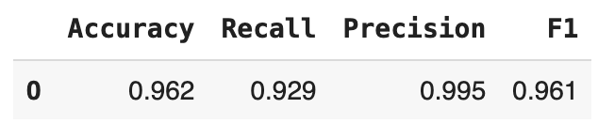
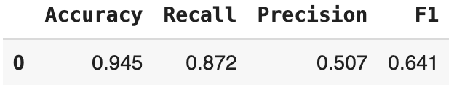
Productionize and test the final model using pipelines
Training Data
A simple pipeline has been used, one that has one single step: running the model
The result is very similar to that of the "unpiped" model: The pipeline model trained on undersampled data generalizes better on accuracy than on recall but worse on precision and F1
As discussed earlier, V36 and V18 are by far the most important features of the tuned random forest classifier trained on undersampled data, followed by V39
Test Data
Link to Appendix slide on model assumptions

Slide 17
APPENDIX

Slide 18
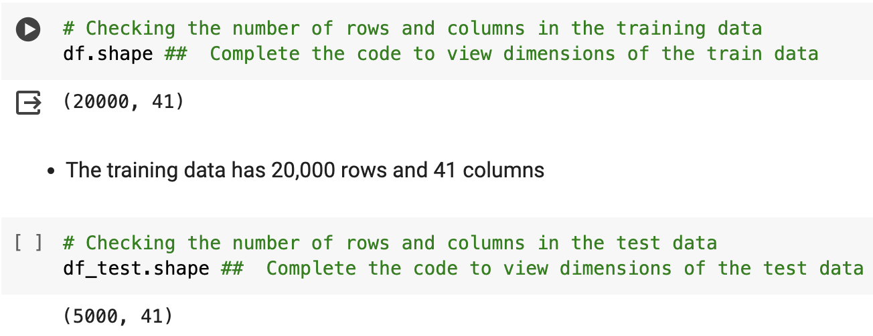
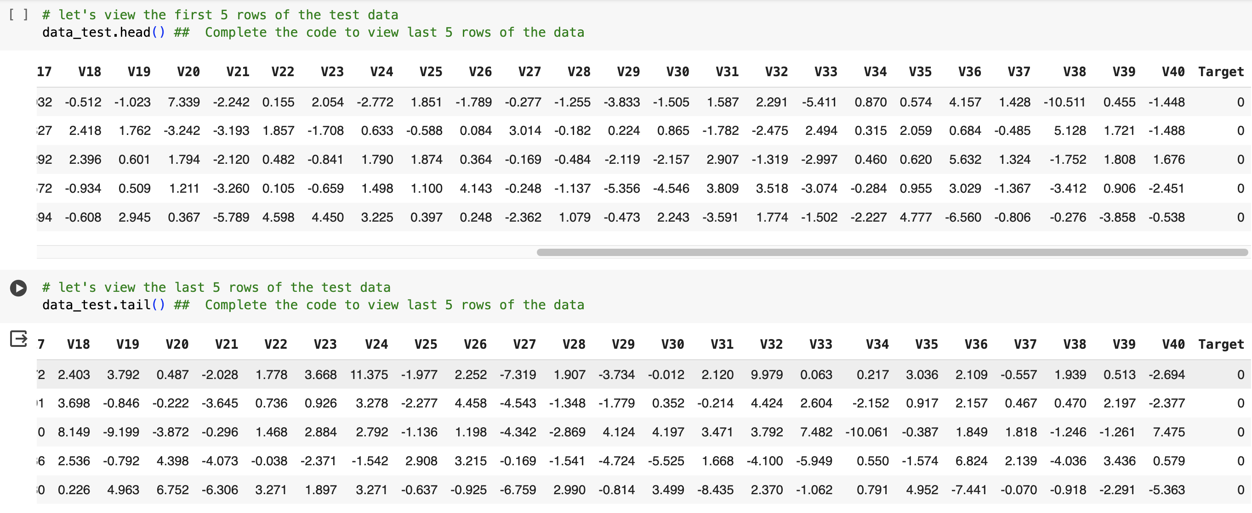
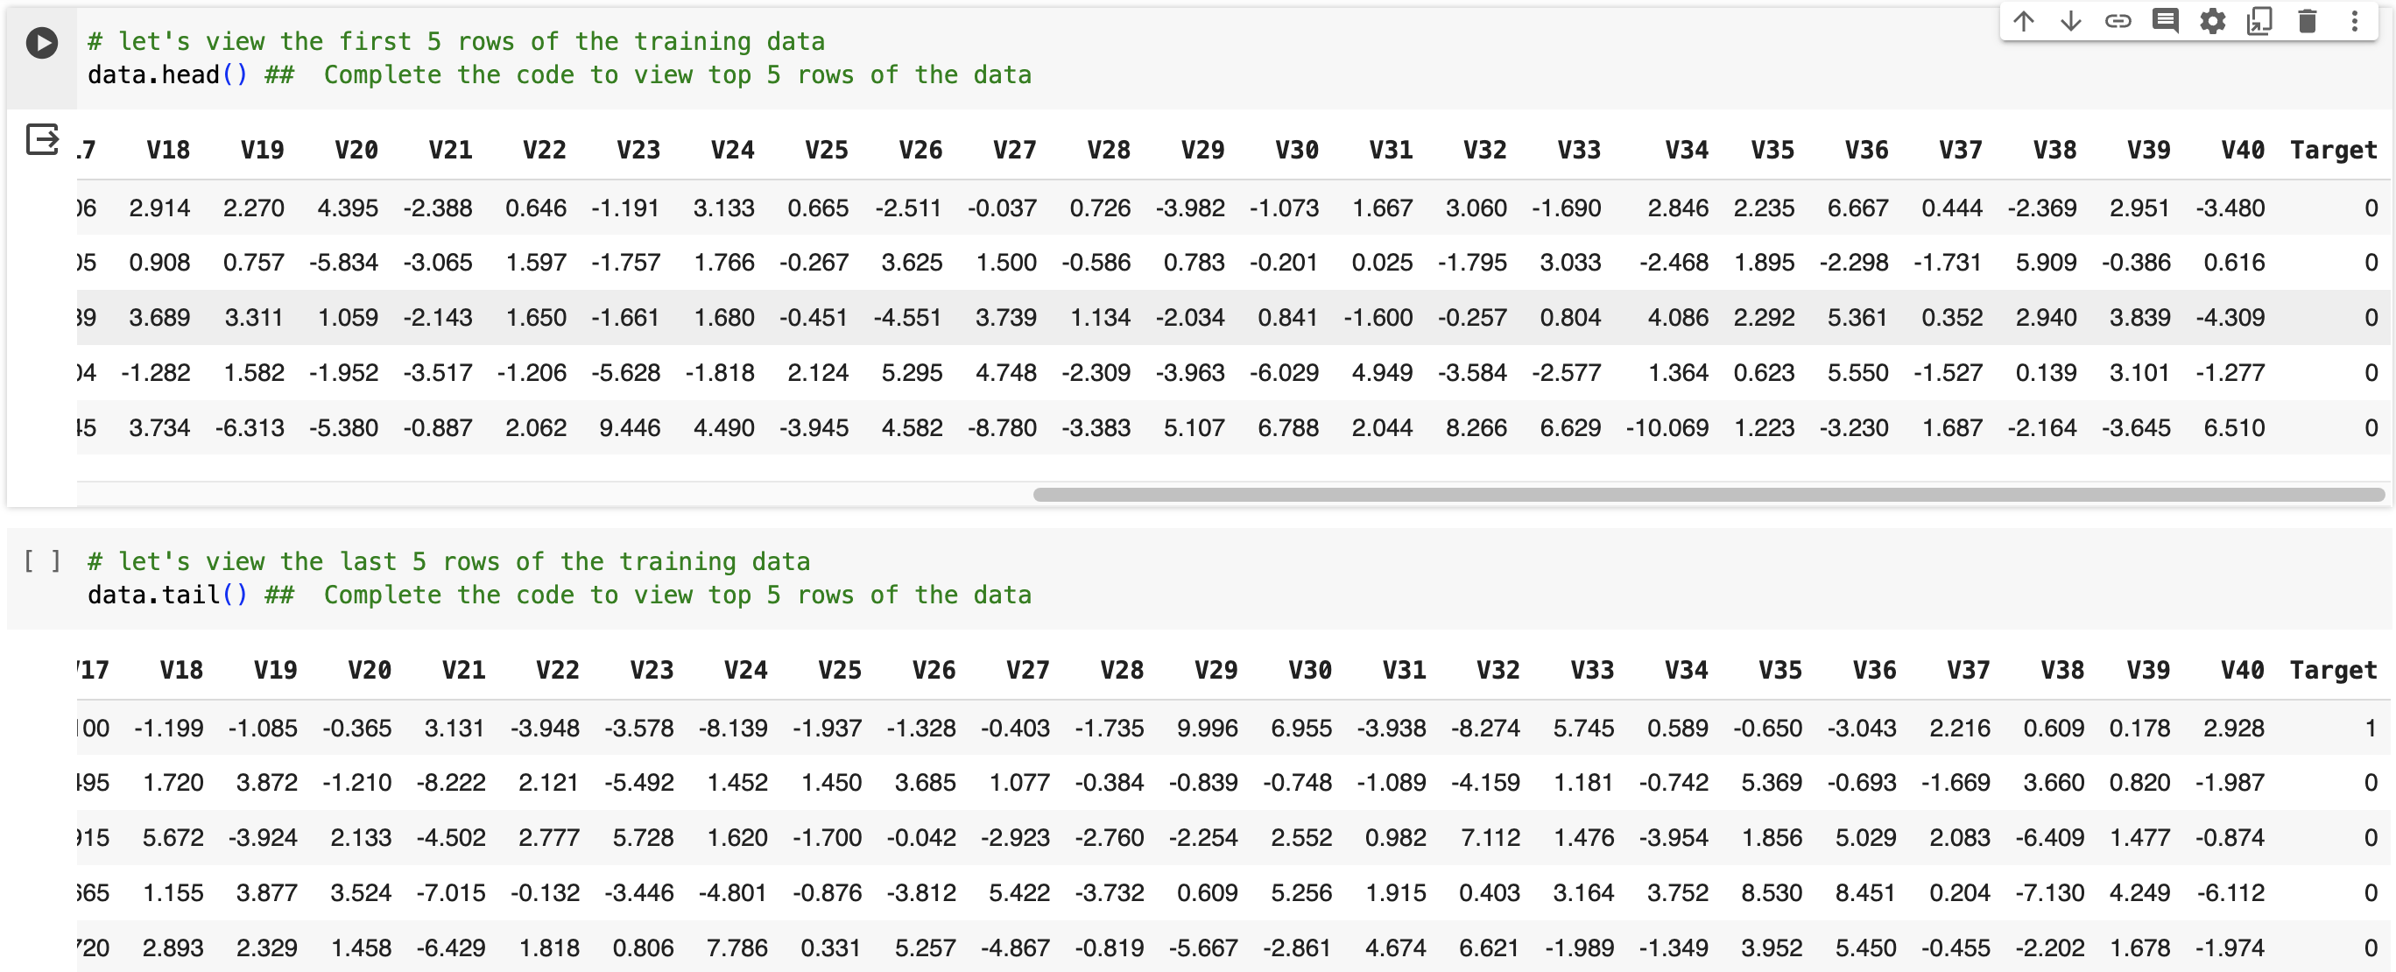
Data Background Check (1/3)
The training data has 20,000 rows and 41 columns
The test data has 5,000 rows and 41 columns
From the few rows displayed, it is already apparent that the positive cases (target = 1) constitute a minority class

Slide 19
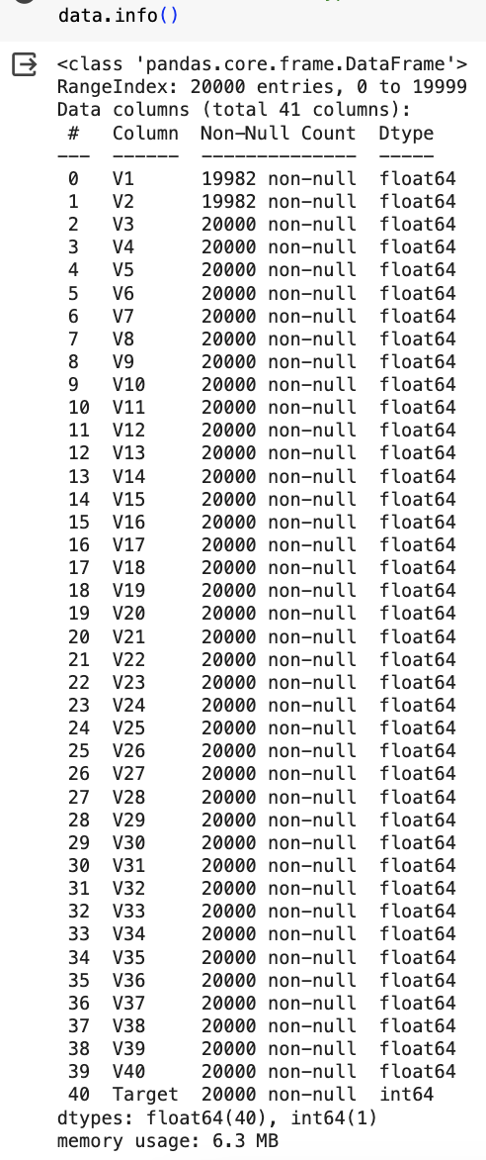
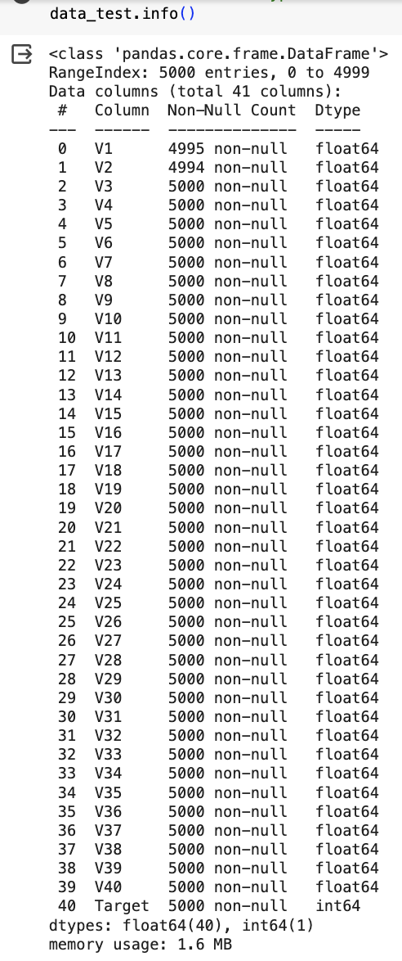
Data Background Check (2/3)
The training and test data sets have only numerical columns (40 float and 1 int)
Columns V1 and V2 contain some missing values
Neither the training data nor the test data has duplicated data
In the training data, columns V1 and V2 have 18 missing values each
In the test data, column V1 has 5 missing values whereas column V2 has 6 missing values

Slide 20
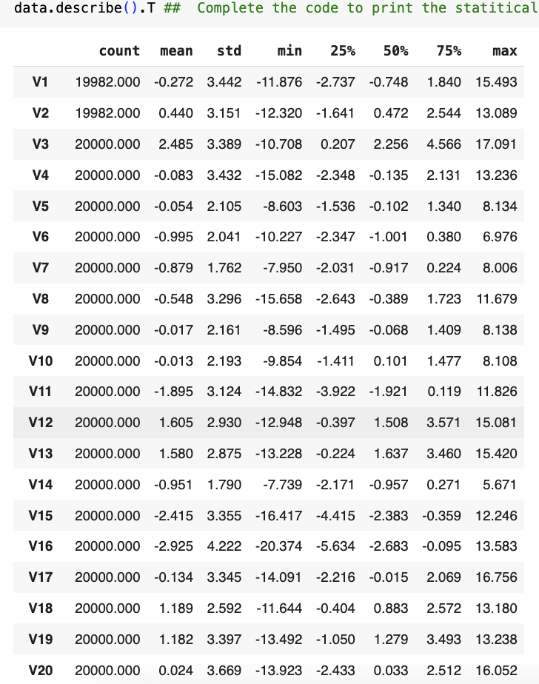
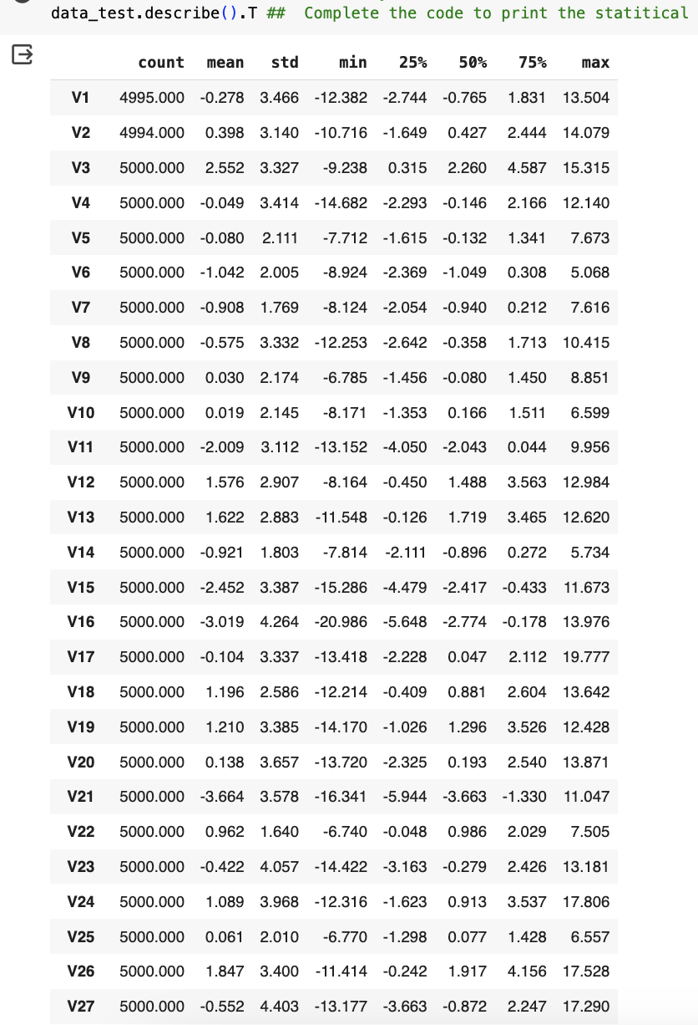
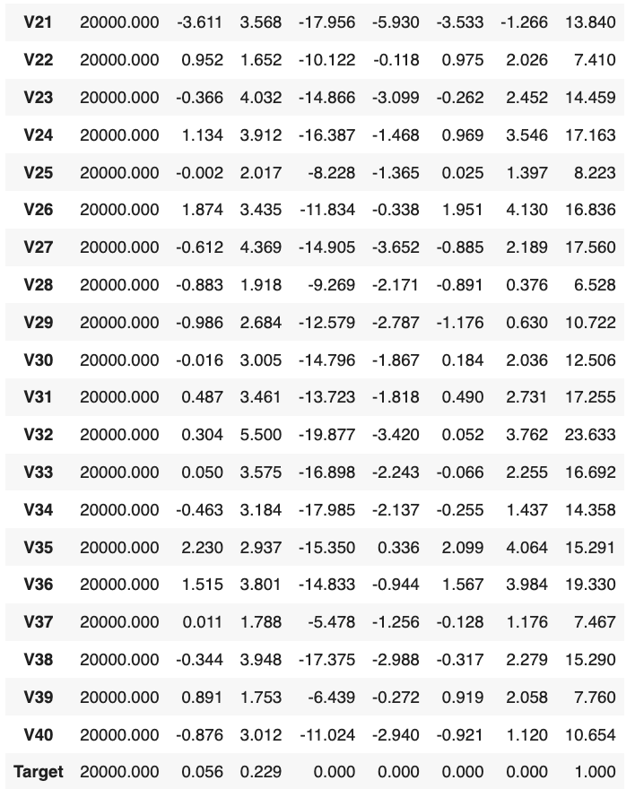
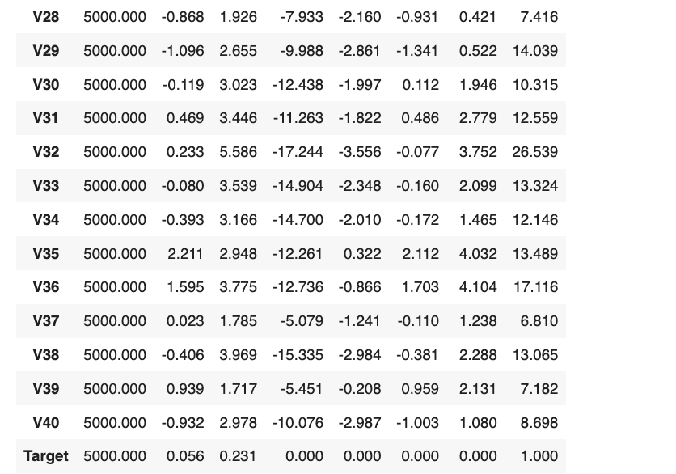
Data Background Check (3/3)
From the statistical summary of both datasets, it can be observed that the mean and median of most, if not all, of the variables are close and almost midway the respective extreme values, suggesting that, for these columns, the data is not very skewed

Slide 21
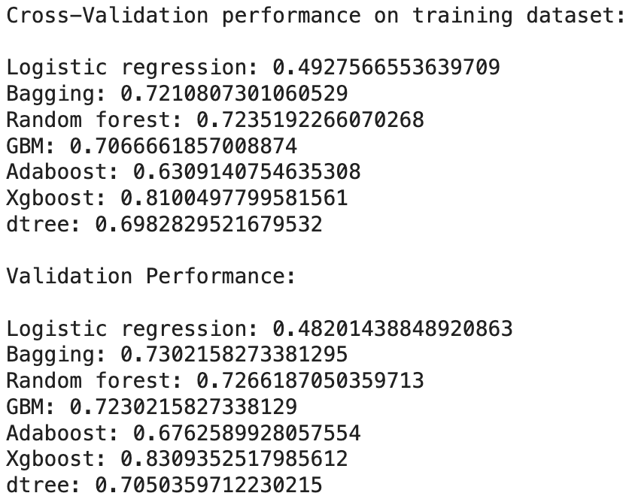
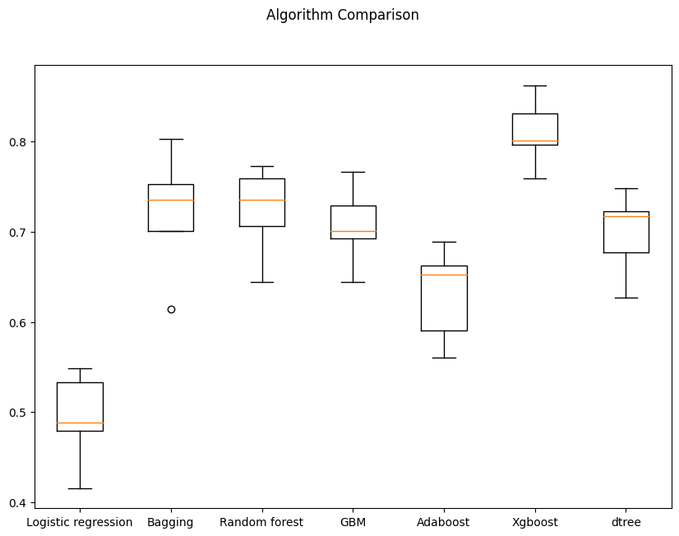
Model Performance Summary (original data)
Graphic Display of Cross-Validation Performance
The three best performing models on the original data are XGBoost, Bagging, and Random Forest
Link to Appendix slide on model assumptions

Slide 22
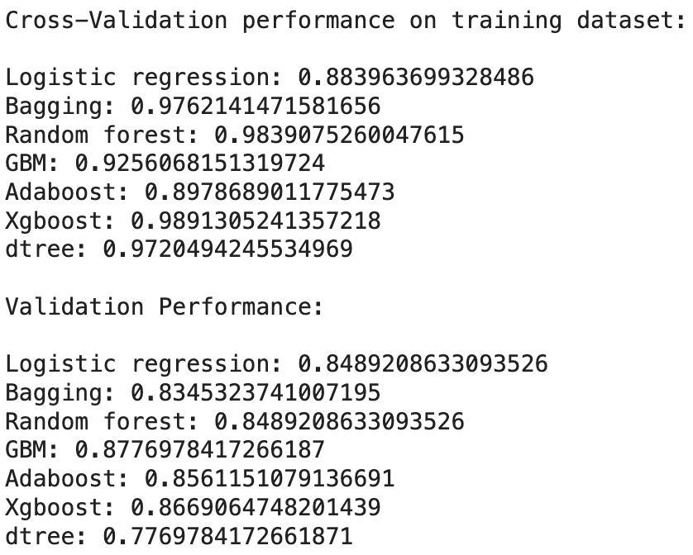
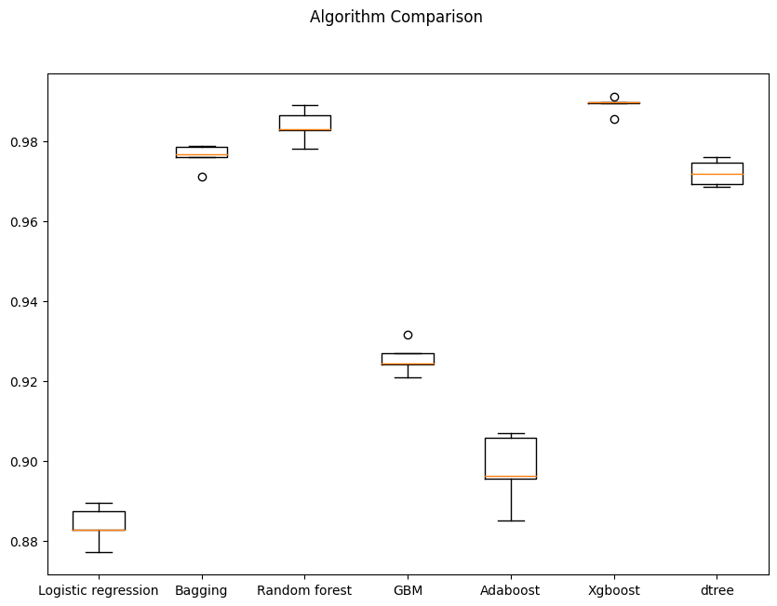
Model Performance Summary (oversampled data)
Graphic Display of Cross-Validation Performance
The models with the three best cross-validation performance on the oversampled training data are XGBoost, Random Forest, and Bagging
Among the models trained on the oversampled training data, those with the three best performance on the validation dataset are GBM, XGBoost, and AdaBoost
Link to Appendix slide on model assumptions

Slide 23
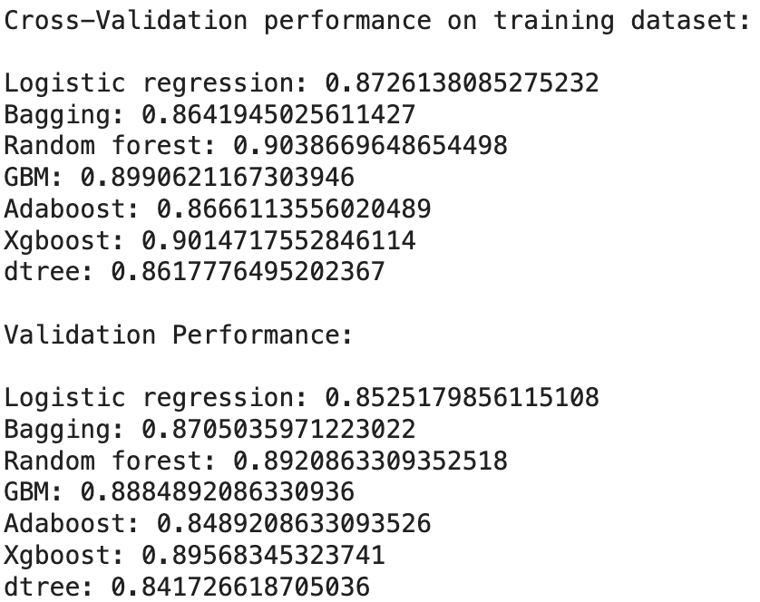
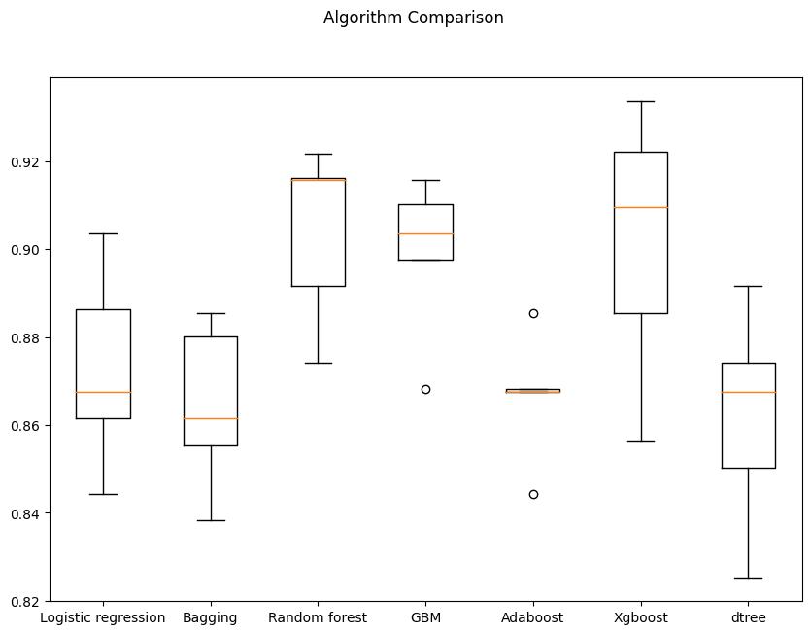
Model Performance Summary (undersampled data)
Graphic Display of Cross-Validation Performance
The models with the three best cross-validation performance on the undersampled training data are Random Forest, XGBoost, and GBM
Among the models trained on the undersampled training data, those with the three best performance on the validation dataset are XGBoost, Random Forest, and GBM (same set of cross-validation best performing models)
Link to Appendix slide on model assumptions

Slide 24
Model Assumption (Model evaluation criterion)
Interpretations of predictions made by each classification model:
True positives (TP) are failures correctly predicted by the model.
False negatives (FN) are real failures in a generator where there is no detection by model.
False positives (FP) are failure detections in a generator where there is no failure.
Most important metric:
We need to choose the metric which will ensure that the maximum number of generator failures are predicted correctly by the model.
We would want Recall to be maximized as greater the Recall, the higher the chances of minimizing false negatives.
We want to minimize false negatives because if a model predicts that a machine will have no failure when there will be a failure, it will increase the maintenance cost.

